Slide 1
BOSTON HOUSING…
Project by:-nimbalkar hrushikesh

Slide 2
The Boston Housing dataset is a seminal resource in machine learning, capturing key attributes influencing housing prices across Boston suburbs. Compiled in 1978 by Harrison and Rubinfeld, it features 506 instances and 14 variables, including crime rates and accessibility to highways. Widely used for regression analysis, this dataset remains integral for testing predictive models and exploring socioeconomic factors impacting real estate values.

Slide 3
The primary objective behind the Boston Housing dataset is to facilitate research and analysis into the factors influencing housing prices in Boston suburbs. By p.roviding detailed information on variables such as crime rates, property tax, and accessibility to highways, the dataset aims to uncover patterns and correlations that can inform housing market predictions

Slide 4
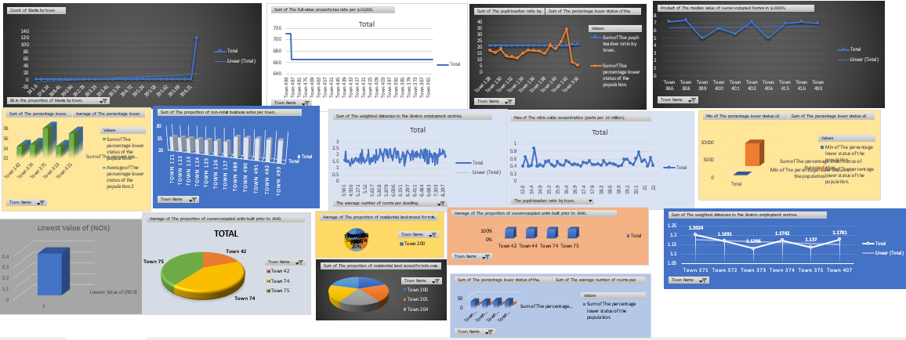
DASHBOARD The Boston Housing dataset dashboard presents a comprehensive overview of housing market variables in Boston suburbs. It includes visualizations such as Bar charts for exploring relationships between features like crime rates and property values, histograms for understanding data distributions, and maps showing geographical trends.

Slide 5
KEY QUESTIONS ADDRESSED BY THE BOSTON HOUSING DATASET
The question set for the Boston Housing dataset typically revolves around understanding the relationships between various socioeconomic and geographical factors and their impact on housing prices in Boston suburbs. Key questions include: How does crime rate. correlate with property values? What effect do tax rates and accessibility to highways have on housing prices? How do neighborhood characteristics like schools and demographics influence real estate demand? These inquiries drive research into developing predictive models that can accurately forecast housing market trends and inform urban planning and policy decisions.

Slide 6
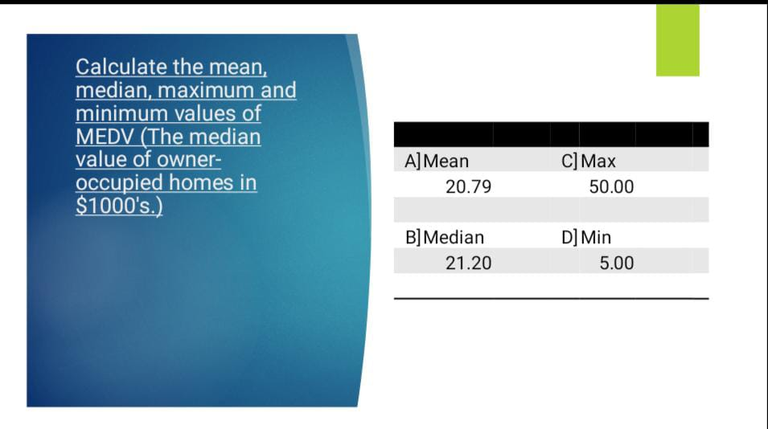
QUESTIONS:-

Slide 7
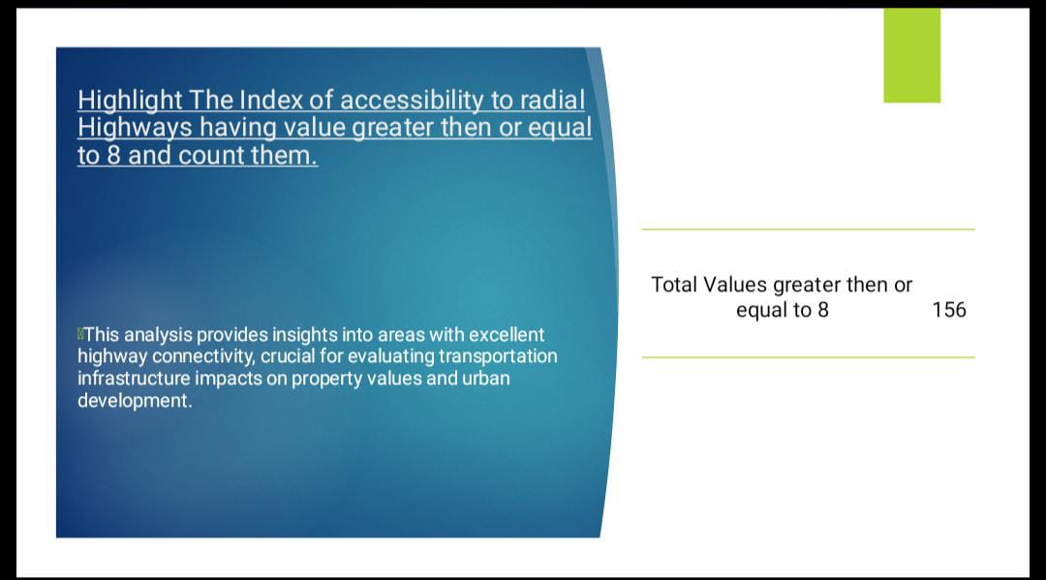
QUETIONS:-

Slide 8
Highlight the rows having the full-value property -tax rate per $10,000 more the $600 This scrutiny helps pinpoint areas with higher tax burdens, essential for assessing affordability and economic implications within Boston's housing market landscape.
FIND AND COUNT THE PUPIL-TEACHER RATIO BY TOWN WHICH IS GREATER THEN OR EQUAL TO 20
This examination provides insights into educational resources and potential impacts on housing demand and community development across Boston suburbs.

Slide 9
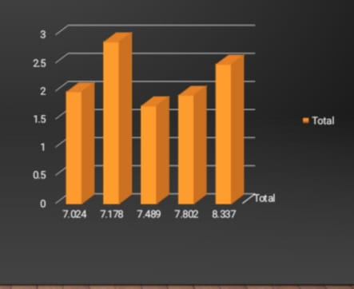
TOP FIVE RESIDENTIAL LAND ZONE WITH REFRENCE TO THE AVERAGE LOWER STATUS OF POPULATION
This analysis sheds light on socioeconomic dynamics within neighborhoods, crucial for understanding community demographics and their implications for housing policies and development strategies in Boston.

Slide 10
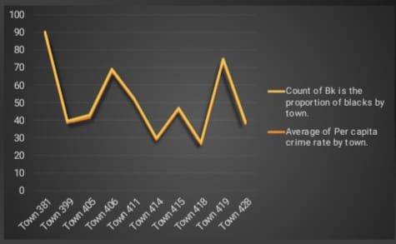
WHAT IS THE PER CAPITA CRIME RATE AND THE COUNT OF BLACKS FOR TOP 10 TOWNS IN INCREASING ORDER FOR TOP 10?
THIS EXAMINATION PROVIDES INSIGHTS INTO CRIME PATTERNS AND DEMOGRAPHIC COMPOSITIONS ACROSS NEIGHBORHOODS, ESSENTIAL FOR UNDERSTANDING SOCIAL DYNAMICS AND INFORMING URBAN POLICY DECISIONS IN BOSTON

Slide 11
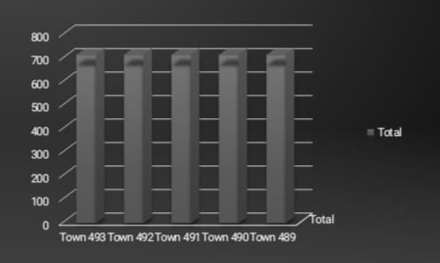
WHAT IS THE COUNT OF THE FULL-VALUE PROPERTY-TAX RATE PER $10,000 ACROSS DIFFERENT TOWNS (ARRANGE THEM IN DESCENDING ORDER AND FIND FOR TOP 5)
This analysis provides insights into tax distribution patterns, crucial for evaluating fiscal policies and their impacts on housing affordability in Boston suburbs.

Slide 12
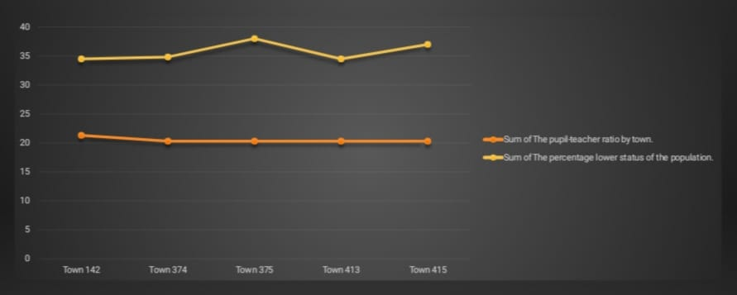
HOW DOES THE SUM OF PUPIL-TEACHER RATIO COMPARE WITH THE SUM OF PERCENTAGE OF THE POPULATION IN LOWER STATUS BY TOWN? (FOR TOP 5)
This comparison offers insights into educational resource allocation and socioeconomic disparities within communities, essential for understanding local dynamics and informing equitable development strategies in Boston suburbs.

Slide 13
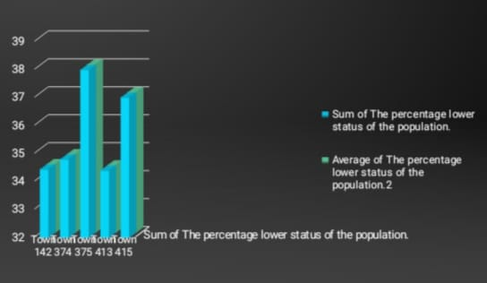
PLOT A BAR GRAPH INDICATING THE DISTRIBUTION OF SUM AND AVERAGE OF THE PERCENTAGE LOWER STATUS OF THE POPULATION IN TOP 5 TOWNS
This visualization provides a comparative view of socioeconomic conditions across these communities, crucial for understanding disparities and guiding social policy interventions in Boston suburbs.

Slide 14
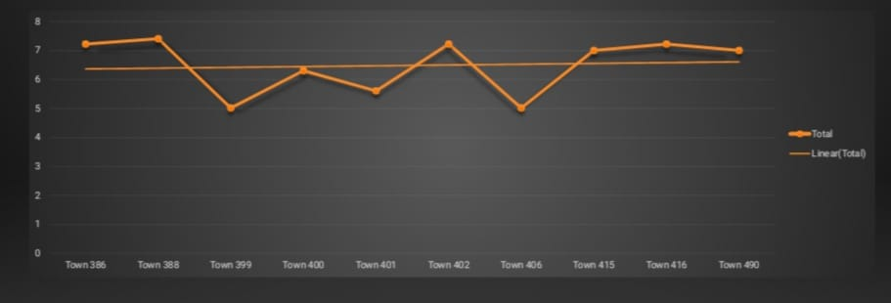
HOW DOES PRODUCT THE MEDIAN VALUE OF OWNER OCCUPIED HOMES COMPARE ACROSS DIFFERENT TOWNS OR REGIONS? (IN DESCENDING ORDER AND FIND FOR BOTTOM 10)
This analysis offers insights into housing market variability and affordability challenges, essential for assessing economic disparities and informing housing policy decisions in Boston suburbs.

Slide 15
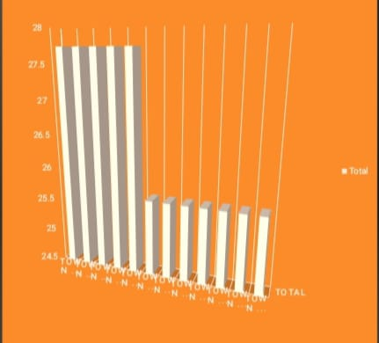
GRAPHICALLY REPRESENT THE SUM OF FIRST TOP & TOWNS WITH RESPECT TO PROPORTION OF NON-RETAIL BUSINESS ACRES PER TOWN
This graphical representation offers a clear depiction of business distribution and economic activity levels across these communities, providing insights into local economic landscapes within Boston suburbs

Slide 16
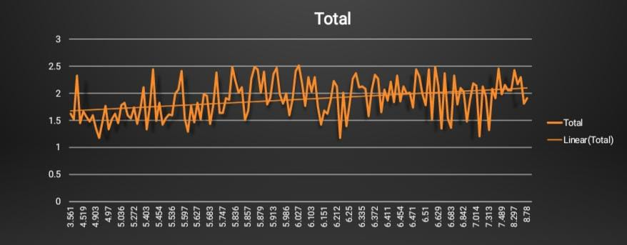
GRAPHICALLY REPRESENT THE SUM OF FIRST TOP 8 TOWNS WITH RESPECT TO PROPORTION OF NON-RETAIL BUSINESS ACRES PER TOWN.
This visualization provides insights into housing accessibility relative to employment hubs, crucial for understanding residential preferences and urban development patterns in Boston suburbs.

Slide 17
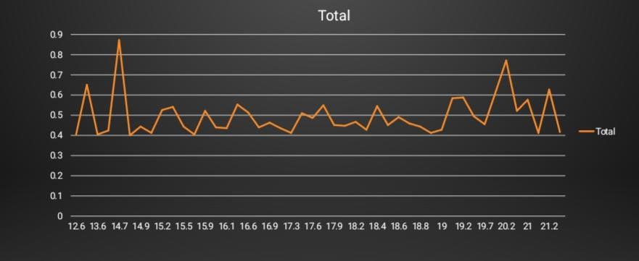
CALCULATE THE PUPIL-TEACHER RATIO BY TOWN WITH MAX OF NITRIC OXIDE CONCENTRATION AND PREPARE A PIOT CHART.
A Line chart is prepared to visually represent this data, providing insights into educational resources relative to air quality levels in different areas of Boston suburbs

Slide 18
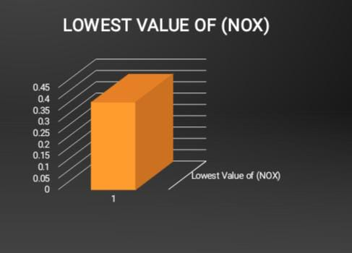
FIND THE LOWEST VALUE OF THE NITRIC OXIDE CONCENTRATION (NOX).
This metric is crucial for assessing air quality and environmental conditions in various locations across Boston suburbs

Slide 19
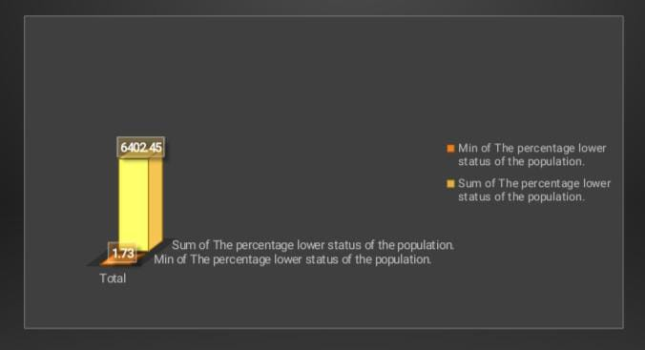
WHAT IS THE MINIMUM SUM OF THE PERCENTAGE LOWER STATUS OF THE POPULATION. (SOLVE USING FUNCTION AND PLOT A BAR GRAPH)
A bar graph is plotted to visually represent this data, providing insights into the socioeconomic distribution and disparities across different areas within Boston suburbs

Slide 20
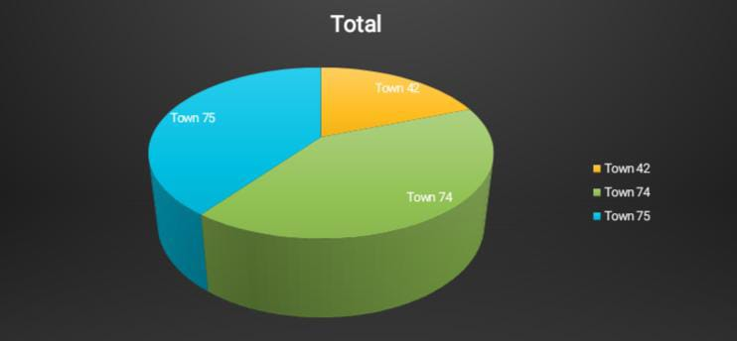
WHAT IS THE DISTRIBUTION OF AVERAGE BOTTOM 3 PROPORTION OF OWNER OCCUPIED UNITS BUILT PRIOR TO 1940 ACROSS DIFFERENT TOWNS?
This examination provides insights into historical housing stock and preservation trends, essential for understanding urban development and architectural heritage in Boston suburbs.

Slide 21
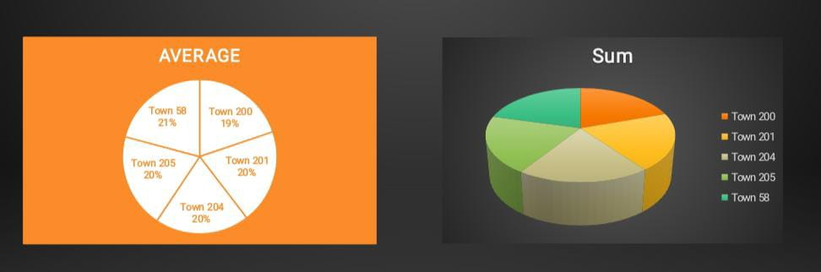
PREPARE TWO DIFFERENT PIE CHARTS VISUALISING THE AVERAGE AND SUM OF THE PROPORTION OF RESIDENTIAL LAND ZONED FOR TOTS OVER 25,000 SQ.FT. IN ANY 5 TOWNS
These visualizations provide insights into land use regulations and urban planning priorities across different neighborhoods in Boston suburbs.

Slide 22
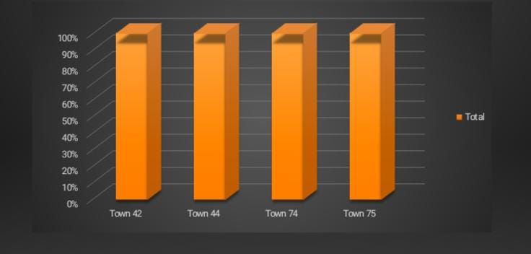
AVERAGE OF ANY 4 TOWNS HAVING DIFFERENT PROPORTION OF OWNER OCCUPIED UNITS BUILT PRIOR TO 1940
This analysis offers insights into preservation efforts and demographic trends shaping residential areas within Boston suburbs.

Slide 23
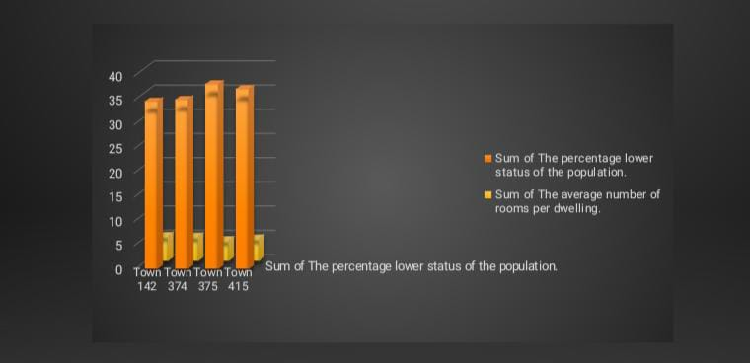
HOW DOES THE SUM OF PERCENTAGE LOWER STATUS OF THE POPULATION COMPARE WITH THE SUM OF AVERAGE NUMBER OF ROOMS BY TOWN? (FOR TOP 4)
This analysis provides insights for understanding community dynamics and guiding equitable development strategies in Boston suburbs.

Slide 24
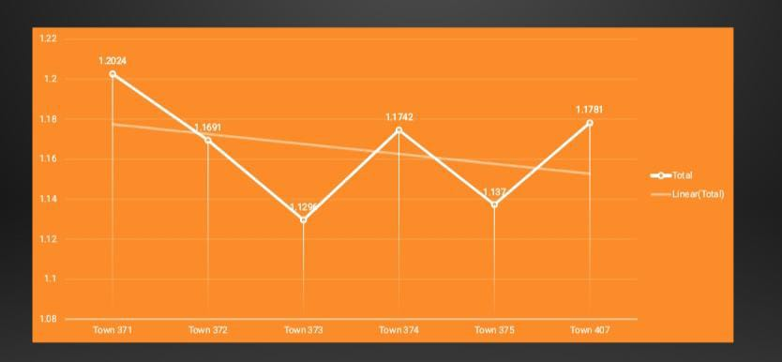
GRAPHICALLY REPRESENT THE SUM OFBOTTOM 6 TOWNS WITH RESPECT TO THE WEIGHTED DISTANCES TO FIVE BOSTON EMPLOYMENT CENTRES
This graphical representation provides insights into accessibility to employment hubs and urban development patterns in less centrally located areas of Boston suburbs.

Slide 25
CONCLUSION:
ACTORS INFLUENCING HOUSING PRICES: THE DATASET REVEALS THAT FACTORS SUCH AS CRIME RATES, PROXIMITY TO EMPLOYMENT CENTERS, AND ACCESS TO AMENITIES SIGNIFICANTLY IMPACT HOUSING PRICES IN BOSTON SUBURBS.
PREDICTIVE IACCESSIBILITYNSIGHTS: BY ANALYZING VARIABLES LIKE PROPERTY TAX RATES AND HIGHWAY, PATTERNS AND CORRELATIONS EMERGE THAT HELP PREDICT FUTURE TRENDS IN THE HOUSING MARKET.
3. POLICY AND PLANNING: INSIGHTS FROM THE DATASET INFORM POLICYMAKERS AND URBAN PLANNERS IN MAKING DECISIONS RELATED TO ZONING, INFRASTRUCTURE DEVELOPMENT, AND AFFORDABLE HOUSING INITIATIVES.
4. INVESTMENT OPPORTUNITIES: INVESTORS CAN USE THE DATASET TO IDENTIFY PROFITABLE OPPORTUNITIES AND ASSESS MARKET RISKS BASED ON HISTORICAL AND CURRENT HOUSING DATA.

Slide 26
Thank you

